Slide 1
Intelligent Network Infrastructure
David Meyer, Chief Scientist
NGIP Laboratory

Slide 2
Agenda
What can ML/AI bring to the network?
Huawei’s Approach: Intelligent Network Infrastructure
- The Architecture and Impacts
- Key Technologies
- Case Studies
Roadmap

Slide 3
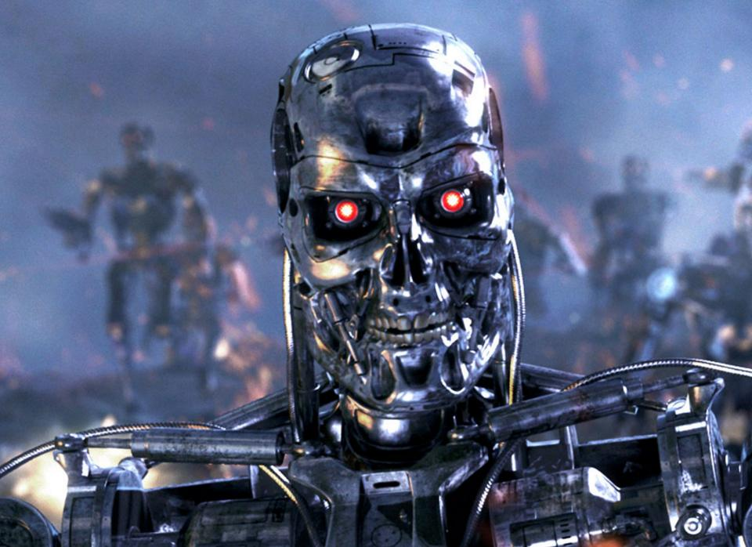
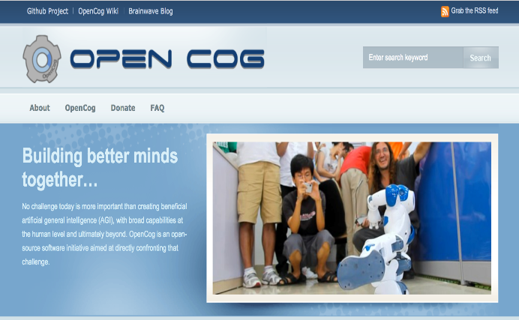
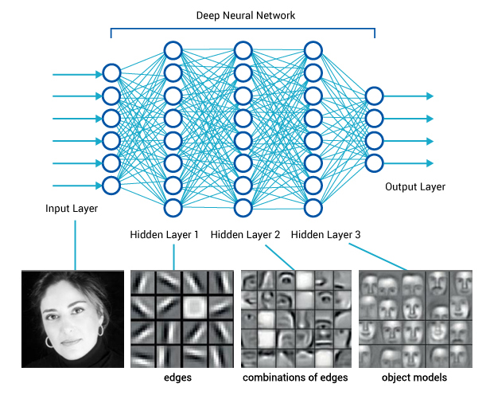
Before We Dive In
What This Talk Is Not About
Artificial General Intelligence (AGI)
Defn: An AGI is an intelligent machine that can successfully perform any intellectual task that a human can
Sometimes: Strong AI
What This Talk Is About
Machine Learning [Focus on Networking]
Solving Engineering Problems
May be used by AGI
Sometimes: Narrow or Weak AI

Slide 4
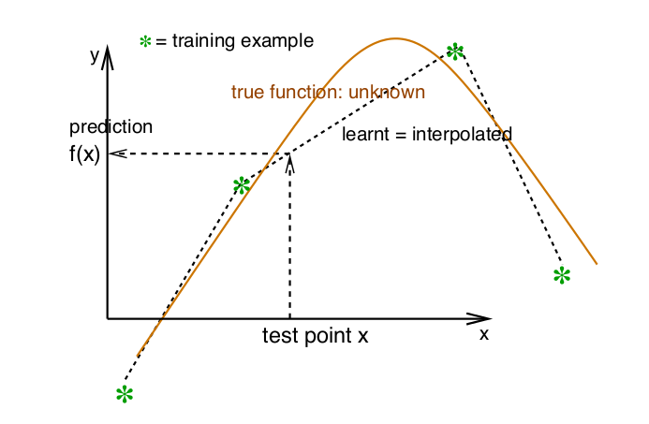
BTW, What Assumptions Are We Making?
Many
Perhaps the most basic assumption/prior: Smoothness
x close to x’ → f(x) close to f(x’)

Slide 5
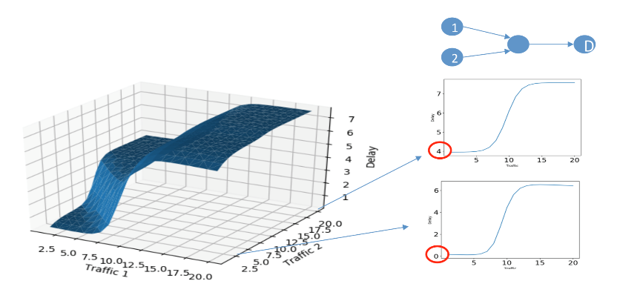
So What Can ML/AI Do For Networks?
Coarse Control
IP traffic is dynamic and bursty at any time scale (self-similarity/scale invariance)
Overprovisioning typical approach to QoS.
Automation
New and services (e.g. IoT) exceed the manual capacity.
Introducing ML/AI into network aims to improve automation (lots of runway)
Wide & Static Safe Margin
Randomness in networks is a reality. Status is only partially predictable, even with ML/AI.
Count the average and maximum, and use them with a wide and static safe margin, which is inefficient, and depend on human experience.
Reactive
Reactive control responds to events after the event occurs.
Need proactivity since reactive might be too late.
Reactive Control
Centralized
Response Period
Emerging
Distributed
Data play more important roles in all of the related functions. As such we must design s/w and h/w for data export (but what format, what meta-data, etc).
Note: Dependence (correlation) does not imply causation. How then can we accomplish many of our primary tasks (e.g. root cause analysis) in a non-ad-hoc fashion?
Local
Dead Corner
Visual field & Precision

Slide 6
ML/AI brings ……
ML/AI can bring new functionality to the network
GOOD AT | VALUE
Solving Complex Problems | Dynamic Control Dynamically control the traffic both in overlay / underlay network and flow / packet level. Real-time and fine-grain policies.
Automatic Decision-making | Lower OPEX Automatic decision-making simplifies the operation of network management. Less manual manipulation, less human cost.
Mining and Modeling | Enable More Learning-based algorithms enable more abilities including prediction, inference, etc., which can proactively guarantee the QoS and QoE.

Slide 7
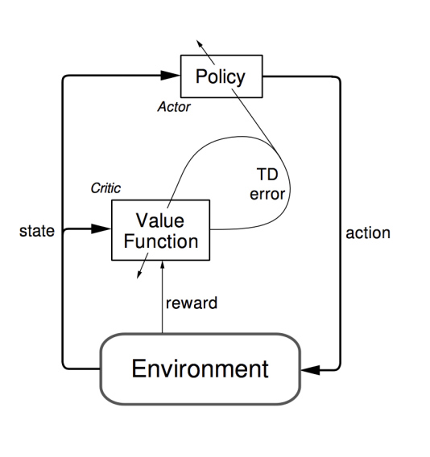
A Route to Network Intelligence
Routing
“Self-Aware Networks: the Cognitive Packet Network and its Performance”
“Towards a cognitive routing engine for software defined networks”
Note: Distance vector routing vs. TD(0) learning
Traffic Engineering
“RLTE: Reinforcement Learning for Traffic-Engineering”
“Experience-driven Networking: A Deep Reinforcement Learning based Approach”
Resource Management
“Resource Management with Deep Reinforcement Learning”
Congestion Control
“TCP ex Machina: Computer-Generated Congestion Control”
“An experimental study of the learnability of congestion control”
 | Rollout
1 | Best Effort: No traffic optimization
2 | Traditional TE: Use static policy to optimize traffic.
3 | Open Loop Control: Based on stage 2, implement traffic monitoring and recognition. Manually make the policies and adjust the network configuration in period.
4 | Closed Loop Control: Based on stage 3, some (but not all) network policies can be deployed and executed automatically and others retain human decision-making (e.g. via recommender systems)
5 | Autonomous Networking: Based on stage 4, all the network policies can be deployed and executed automatically. Again, retain open loop control

Slide 8
Agenda
What can ML/AI bring to the network?
Huawei’s Approach: Intelligent Network Infrastructure
- The Architecture and Impacts
- Key Technologies
- Case Studies
Roadmap

Slide 9

The Architecture
Control APPs
Model
Management
Plane
Control
Plane
Collection
Plane
Modeling
Alg
Control Alg
Eval Alg
Status
Collection
Action
Dispatch
AI
Mng
AI
Control
AI
Data Process
AI Platform
Network Status
Control actions
Training Data Set
Data Mng
Collection
Cleaning
Complement
Management
Plane
Control
Plane
Collection
Plane
Role for ML/AI in every plane, working together with traditional functionality and protocols
Role for ML/AI in most entities, including global (slower) and local (quasi-real time) actions
Data Collection Plane
AI
Mng
AI
Control
AI
Data Process
Measurement
AI Platform
Embedded
AI
Forwarding
Plane
Training Data Set
Data Mng
Forwarding
Network Node

Slide 10
Impact on Control Plane
IMPACT | FROM | TO
Data-driven self-learning | human study & design | algorithms learn pattern from data and optimize
High frequency operations for real-time optimization | manually adjustment in months | automatic operation in seconds, even milliseconds
Emerging of self-shaping control protocols | human designed protocols | self-develop protocols: AI decides what and when to communicate
BTW, what is the difference between dependence (e.g. correlation) and
causality, and can you learn causal relationships from observations (data)?

Slide 11
Impact on Management Plane
IMPACT | FROM | TO
Data-driven self-learning | human study & design | algorithms learn pattern from data and optimize
Human interfaces | all the details | hide details and only provide KPIs
Information type | historical statistics, current status monitoring, tons of logs | summarized, analyzed, predicted report
BTW, when we observe some data, what are we really observing?
The joint distribution over the variables of interest, $p(x_{1}\text{,…,}x_{n})$
Also called the Data Generating Distribution (DGD)

Slide 12
Impact on Forwarding Plane
IMPACT | FROM | TO
Data measurement requirement | Limited data measurement | More data measurement needed
Forward Mechanism | Forwarding mechanism matching current control system， like ACLs by configuration | New control system e.g. traffic balancing in forwarding procedure according to specified percentage of each next hop in routing table
AI into forwarding plane | Reactive/Preset resource reservation | predictive resource allocation

Slide 13


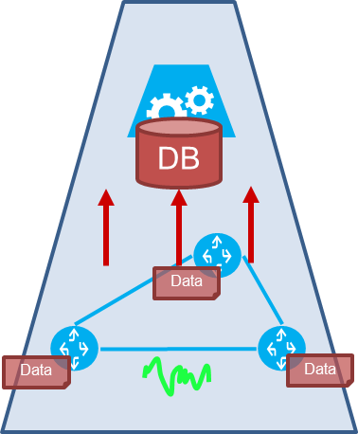
Emergence of the “Collection” Data Plane
As with the network and service complexity increases, data will play an increasingly important role
- Data collection is a complex and heavy load work. It needs careful organization and design.
- Support multi-layers
- Functions: network state measurement, centralized or distributed, planning/optimization/compression of measurement.
Large-scale
Aggregation
Data Plane
Distributed
Data
DB
Small-scale
Aggregation
Data
Data
Small-scale. Feedback and reactive when necessary.
Data
Data
Data
Large-scale. Data become an abstract of lower infrastructure and services. Become an independent and global view of network
Middle-scale. Data become a set of network states. Support the local controller functions

Slide 14
Agenda
What can ML/AI bring to the network?
Huawei’s Approach: Intelligent Network Infrastructure
- The Architecture and Impacts
- Key Technologies
- Case Studies
Roadmap

Slide 15
Modern ML: Theory + Engineering
Theory
Reinforcement learning to learn control (actions). Contrast inference (regression, classification, …)
Stochastic modeling & variational inference: Variational AutoEncoder，Bayesian Networks
Hierarchical/multi-layer Control
Self-shaping protocol
Temporal prediction (RNNs such as LSTM, etc)
…
Engineering
Open loop control (e.g. recommender system), digital twins, threshold limitation, online-learning …
Rapid learning: limit the impact of the learning phase (for example, low-shot learning)
Scalability
Forwarding plane ML
Of course, if we’re in the forwarding plane we need wire speed learning and inference
Memory a crucial resource in forwarding ASICs, …
Efficient data collection: Selective data measurement, telemetry
What is the ”effective distance” between Theory and Engineering in ML these days?

Slide 16
Agenda
What can ML/AI bring to the network?
Huawei’s Approach: Intelligent Network Infrastructure
- The Architecture and Impacts
- Key Technologies
- Case Studies
Roadmap

Slide 17



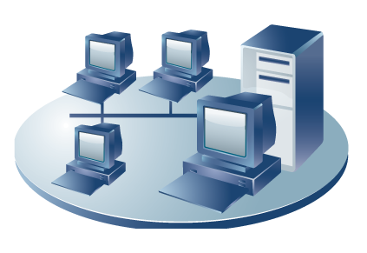


Case Study 1: Intelligent Traffic Balancing
Learning
Inference
Ctrl Loops
AI + TE
____Goal
Congestion avoidance.
Real-time load balancing.
Improving QoS
Data
Data
collector
AI
controller
Controller
____Solution
Multi-path route computation by traditional Graph Theory algorithm, for each Ingress-Egress pair.
Online Reinforcement Learning algorithm adjusts traffic distribution at every router to multiple outgoing ports.
Modified forwarding plane forwards packet according to the percentage, in flowlets to keep packet order
CORE
____Benefit
Reducing Max-Link-Utilization by 23% (vs ECMP)
Reducing data loss by 64% (vs ECMP)
Reducing link delay by 19% (vs ECMP)
Achieving close performance on both MLU and packet loss with CONGA (ms-level distributed control) by second-level centralized control, and better performance on delay
Automatically adapts to evolving traffic pattern and network status
AGG
ACC
MAN (Metro Area Network)

Slide 18




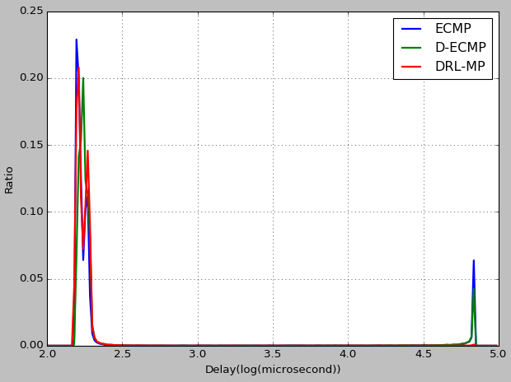
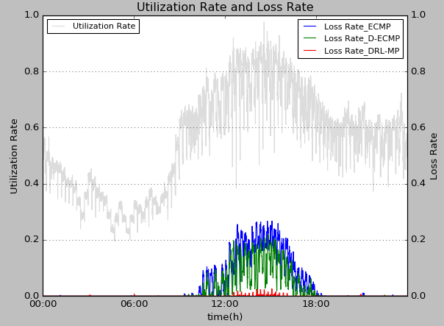
Case Study 2: Intelligent Overlay Routing
AI + SD-WAN
Learning
Inference
Ctrl Loops
Data
End-to-End Quality
Controller
Traffic Rerouting
Probe
____Problem
Underlying networks are black-boxes
WAN path quality keeps changing, only partially predictable
Optimal leased-line/VPN traffic routing is based on estimated path quality
ISP networks are black-boxes to users.
Routes, link status are changing and unknown.
Only end-to-end quality is measureable.
____Solution
Online Reinforcement Learning algorithm provides adaptive routing from dynamic path quality
Multiple objective: Delay, jitter, dropping, cost
Probability Distribution
of Delay
Traffic
____Benefit
30% average delay improvement over test bed (vs D-ECMP)
Automatically adapts to evolving status of underlying networks
~0.2ms
~50ms
Packet Loss
Delay

Slide 19

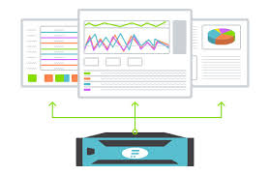
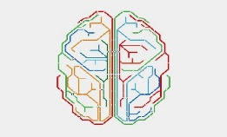


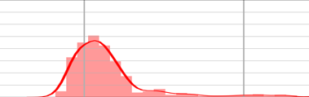

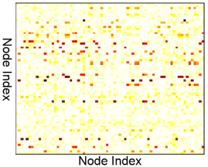

Case Study 3: QoS Inference Engine
Learning
Inference
Ctr Loops
AI + Modeling
Data
Controller
Precise Network Capacity Planning
Real-time QoS Monitoring & Anomaly Detection
Smarter AI design
with QoS prediction
Reliable AI control for SLA guarantee
Applications
Support customizable and rich QoS models (e.g., delay, jitter and loss); Enable real-time SLA guarantee throughout the network, including the precision network expansion, real-time QoS monitoring and anomaly detection, reliable AI control.
Human
(Open Loop)
AI Controller
(Close Loop)
Network QoS (delay,jitter, loss…)
Infer QoS distribution
Achieve millisecond-level QoS inference based on generative ML algorithms
QoS Inference Engine
LSTM:
Traffic feature extraction
VAE:
QoS distribution reconstruction
Inference
Self-learning modeling directly from historical traffic; Achieve automatic inference of full probability distribution, e.g., the parallel inference for 99/90-percentile and mean values.
Collect traffic matrix
along time

Slide 20
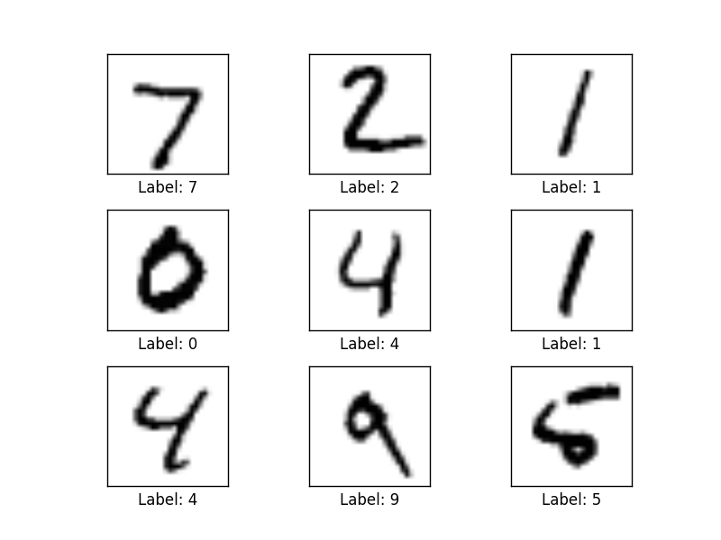
Aside: What is an Autoencoder?
To understand what an autoencoder is, we need a data set
I’m using MNIST here because you can easily visualize what is going on. In our case, instead of the input being vectors of {0,1} we will have vectors of counters of various features s/a bandwidth, and other network and host based metrics/KPIs.
MNIST: 28x28 Grayscale Handwritten Digit Dataset
Training set: 55000 images
Test set: 10000 images
Validation set: 5000 images
Features here are pixels (28x28 = 784)

Slide 21
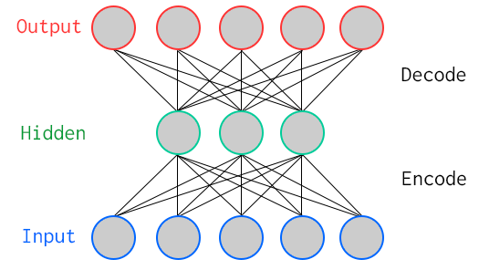
Autoencoder? Special Kind of Neural Network
784
100
784
Key Characteristic: Hidden layer has fewer units than input/output → Compression
Goal: Minimize reconstruction (decode) error
How to define error (loss, cost)?
Binary classification: Threshold reconstruction error → normal/abnormal
Unsupervised learning

Slide 22
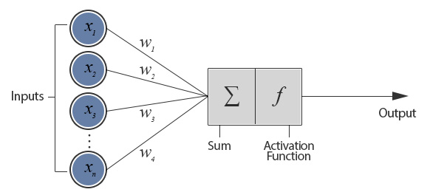
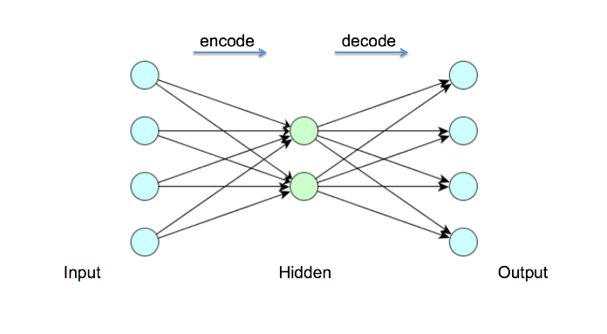
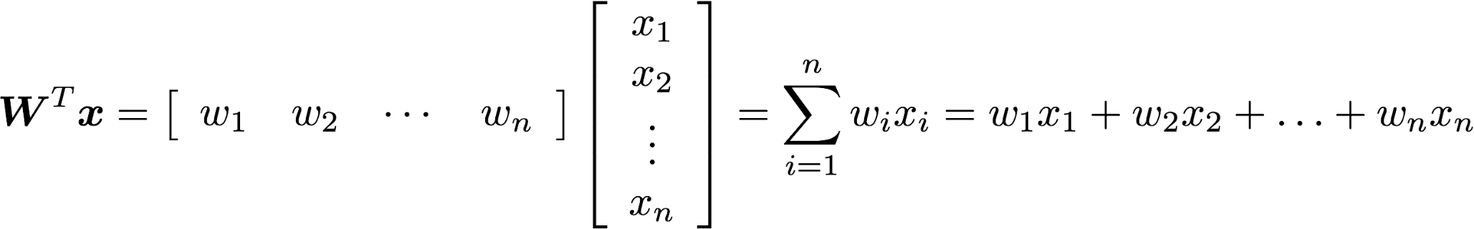
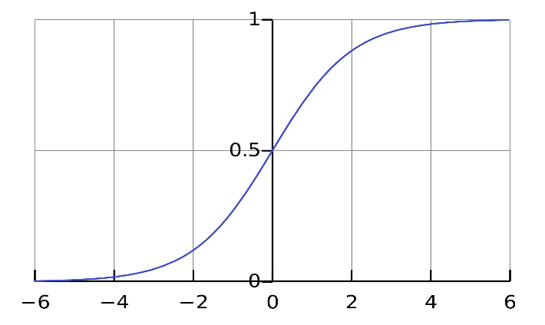
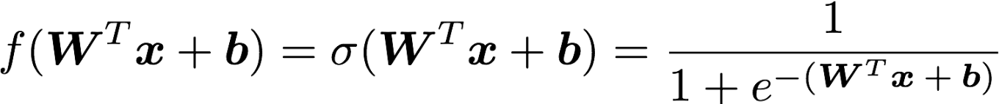
But First: What Does A Single Neuron Do?
Inner (dot) Product
784
100
784
BTW, how many parameters?
784x100 + 100x784 = 156800

Slide 23
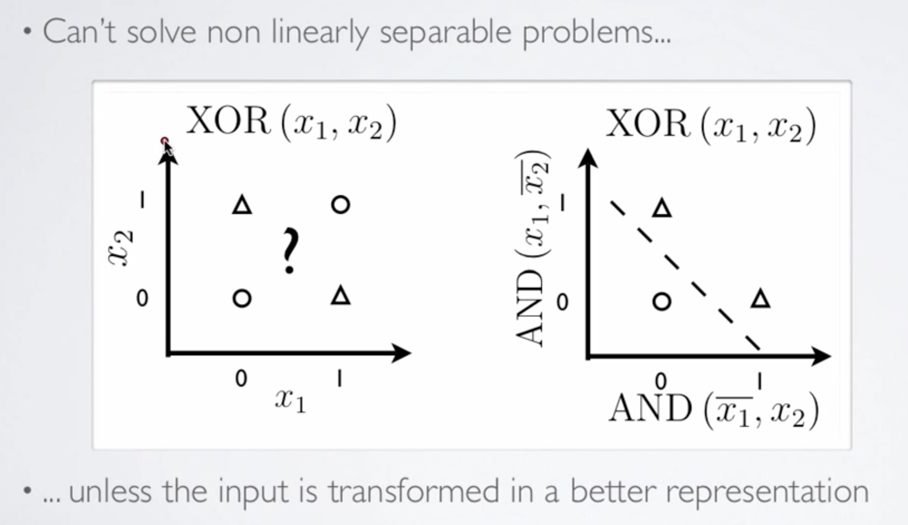
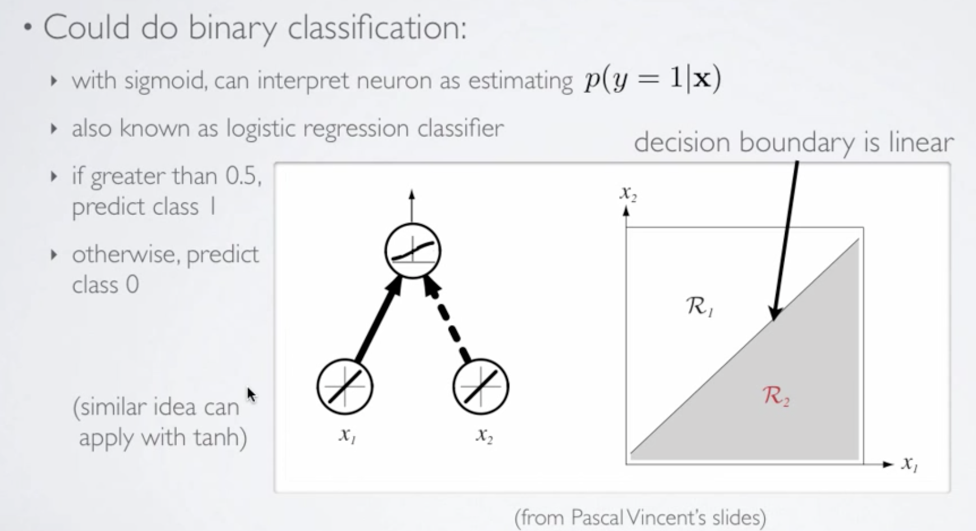
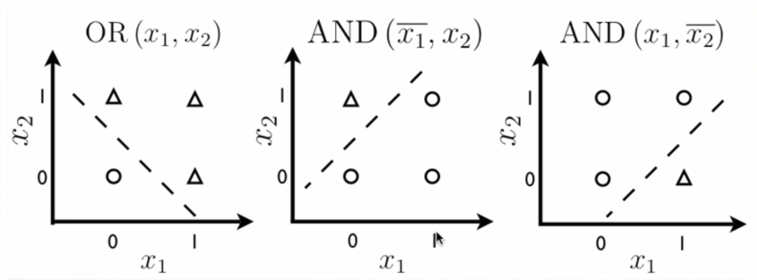
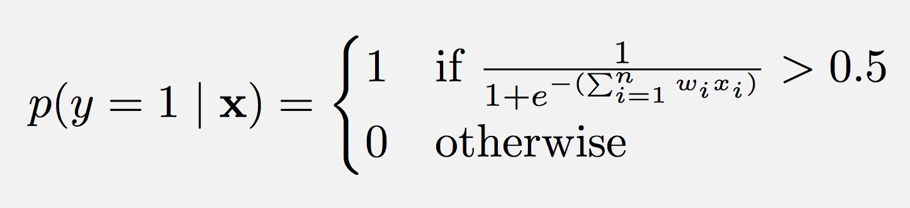
So What Kinds of Things Can a Single Artificial Neuron Compute?
Can Solve Linearly Separable Problems
Graphic courtesy Hugo Larochelle

Slide 24
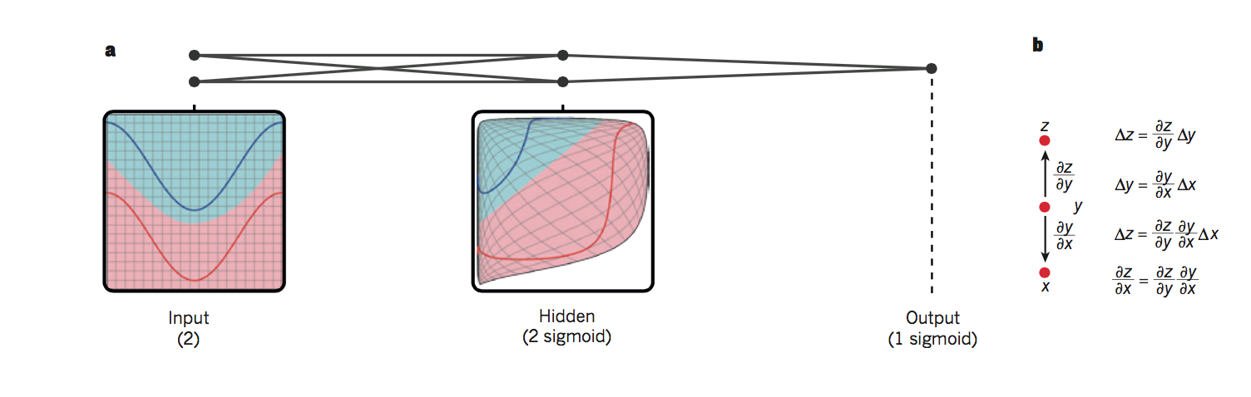

So What is Really Happening Here?
Linear Decision Boundary
Target function represented by input data is some twisted up manifold
Deep Nets disentangle the underlying explanatory factors in the data so as to make them linearly separable
Graphic courtesy Christopher Olah
Voronoi diagram under Euclidian distance
Voronoi diagram under Euclidian distance
Linear Separability in a Neural Network
Linear Separability in a Neural Network

Slide 25
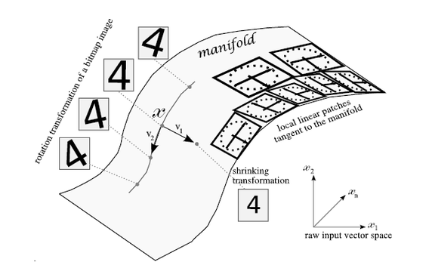
Manifolds?
X is a high dimensional vector (MNIST: 28² = 784)
Data concentrated around a lower dimensional manifold
Hope is to find representation of that manifold
Graphic courtesy http://www.deeplearningbook.org

Slide 26
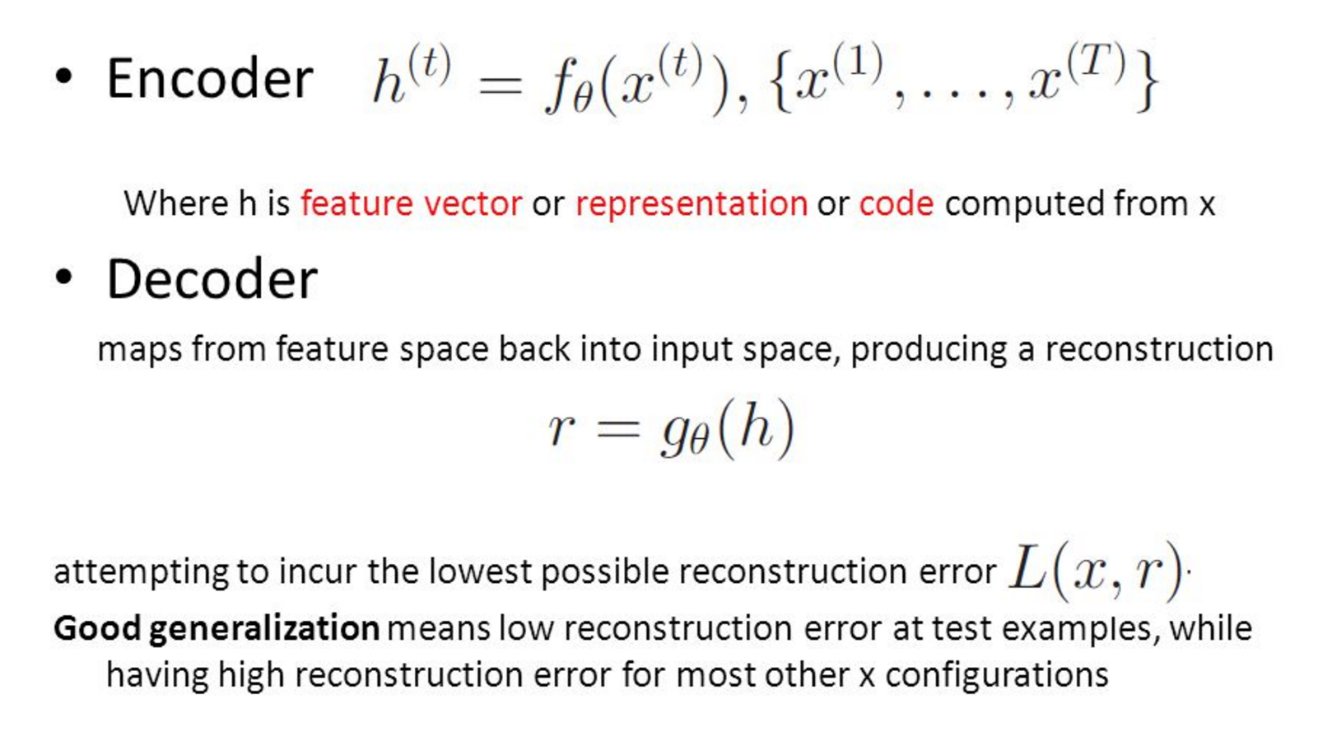
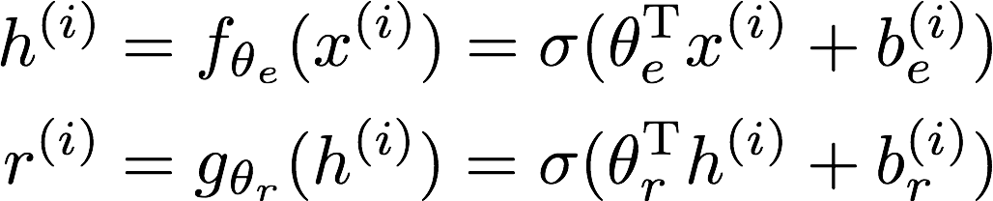
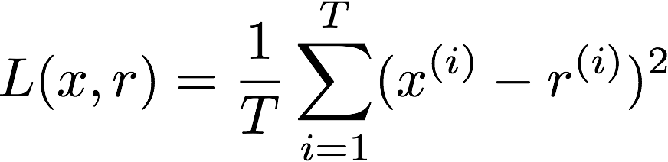
So OK, All Cool, But How Does The Autoencoder Actually Work?
Learning comes down to adjusting the weights (w_{i}’s) so that the loss L(x,r) is minimized. This is the job of backpropagation (calculate the gradients) and gradient descent (find the minima of the loss function).

Slide 27
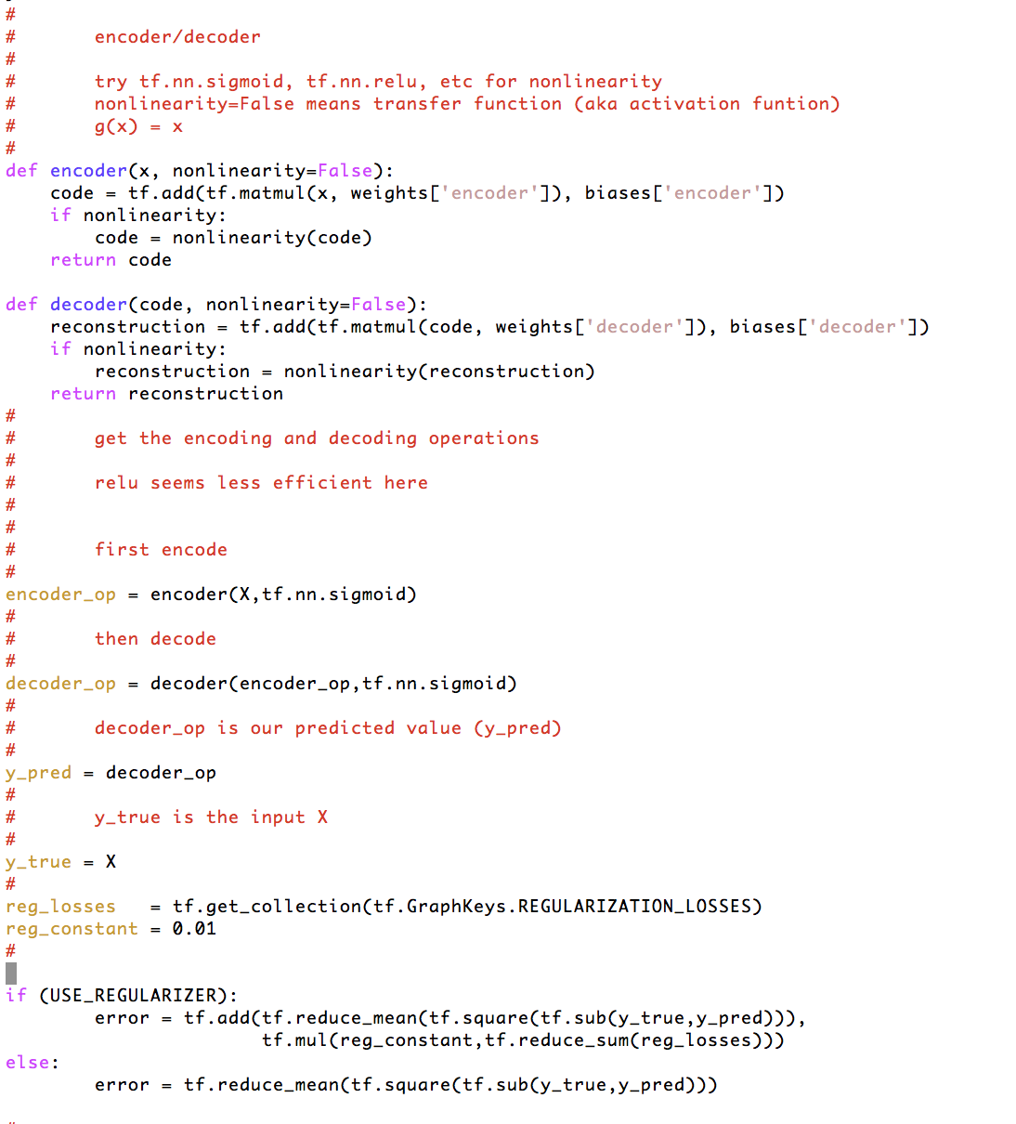

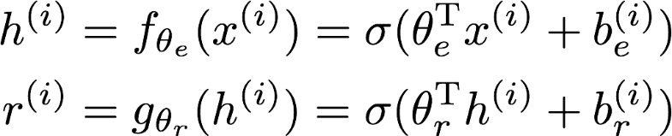
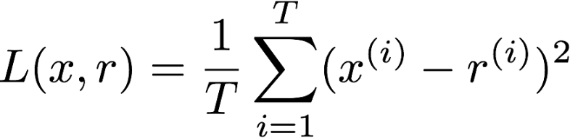
How Hard To Code This Up In Tensorflow?
https://github.com/davidmeyer/ml/blob/master/tensorflow/autoencoder.{py,ipynb}

Slide 28
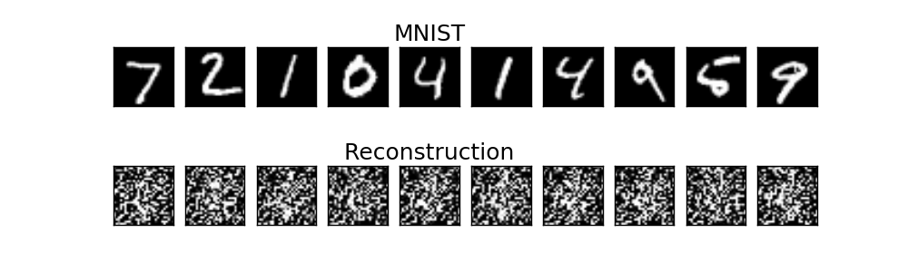
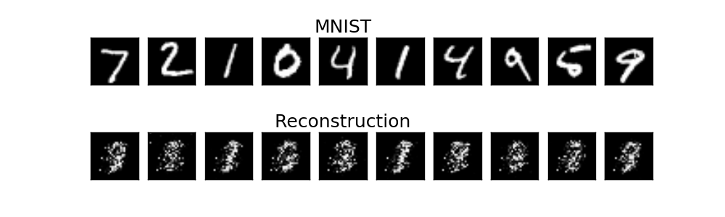
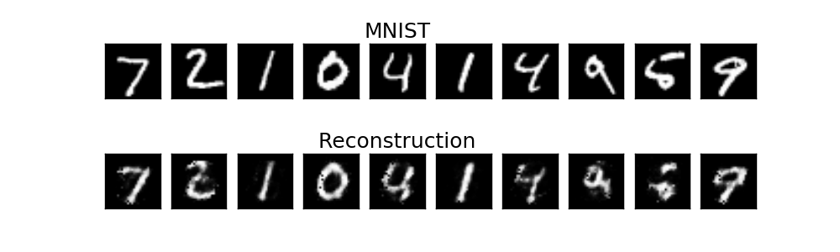
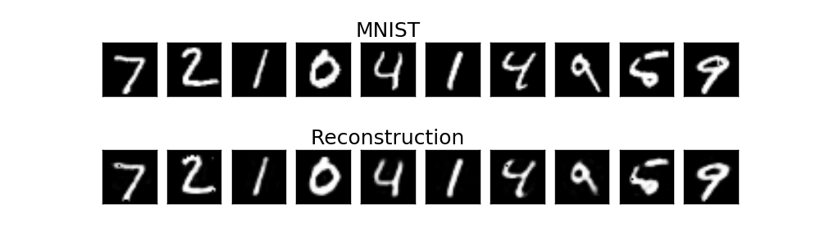
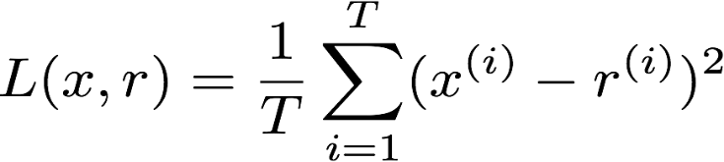
Autoencoder Output
1 example
10 examples
100 examples
1000 examples
After training, the AE gets low reconstruction error on digits from MNIST and high reconstruction error on everything else: It has learned to recognize MNIST

Slide 29
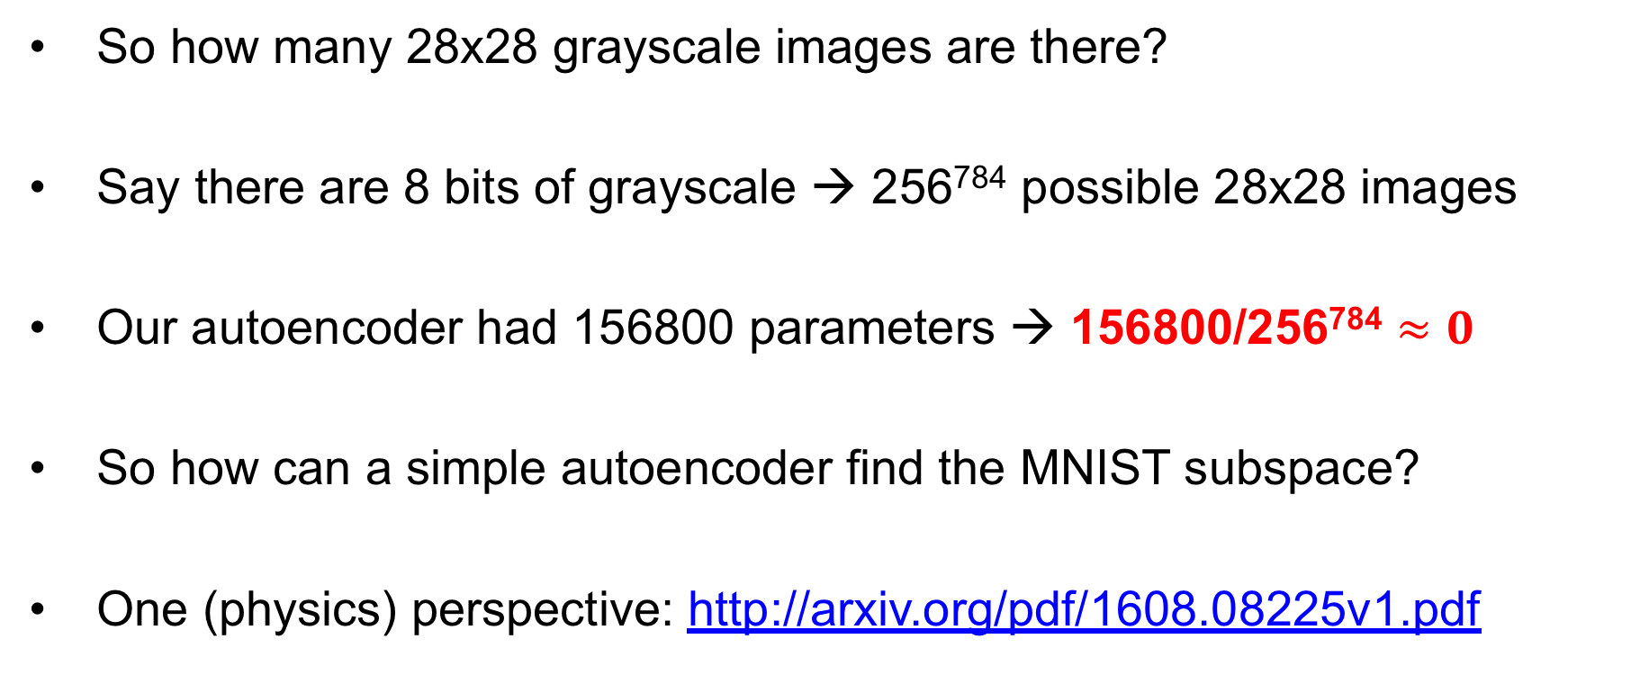
Aside: How Big is the MNIST Space?
So how many 28x28 grayscale images are there?
Say there are 8 bits of grayscale → 256⁷⁸⁴ possible 28x28 images
Our autoencoder had 156800 parameters → 156800/256⁷⁸⁴ $≈0$
So how can a simple autoencoder find the MNIST subspace?
One (physics) perspective: http://arxiv.org/pdf/1608.08225v1.pdf

Slide 30

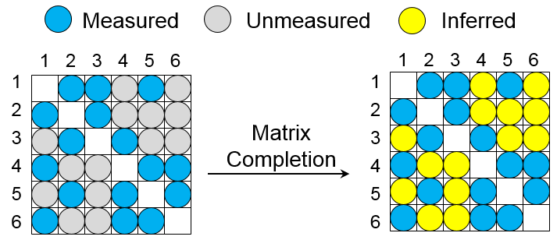
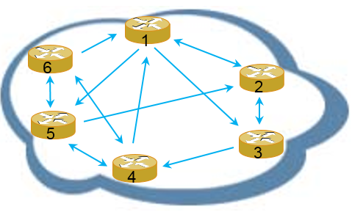
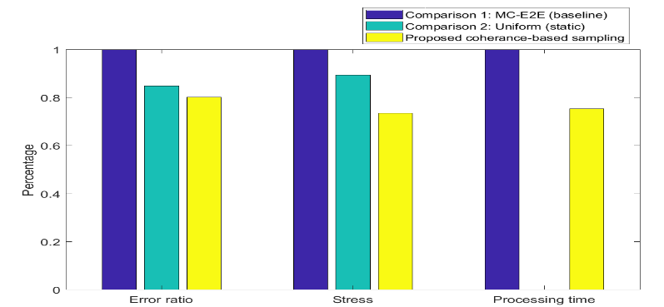
Case Study 4: Intelligent Measurement
Learning
Inference
Ctrl Loops
AI + Measurement
AI App & Others
Data
Controller
Data-driven
Addresses the data requirement for intelligent applications and network insight
Network visualization to gain the vision of network performance
Capability of measurement for large-scale networks
Intelligent measurement
Data recovery via matrix completion by measuring only 20% of node-pairs
Online schedule of measurement points based on matrix coherence feature
Improve 20%，27% and 25% on recovery accuracy, fitness stress and processing time respectively (vs MC-E2E)
Selective measurement & recovery by Coherence-Based Sampling
Network
20%
27%
25%
Performance improvement on latency measurement (Note that comparison 2 of uniform sampling is static with no online scheduling).

Slide 31
Agenda
What can ML/AI bring to the network?
Huawei’s Approach: Intelligent Network Infrastructure
- The Architecture and Impacts
- Key Technologies
- Case Studies
Roadmap

Slide 32
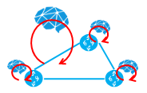
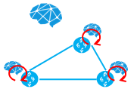
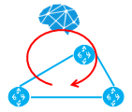
Roadmap
Global optimized
Policy assistant
Admin assistant
Causal analysis
Separate ML/AI applications
e.g. Temporal prediction
Management
Plane
Integrated hierarchical control
Centralized control +
Isolated distributed control
Centralized control
Separate ML/AI applications
Global optimized collection & inference
Intelligent prefetching
Control
Plane
Selective collection & completed by inference
Data cleaning
Measurement Collection
Service optimization @ wire speed
Collection
Plane
Separate optimized operations
e.g. predictive resource management
Additional forwarding options
Probing
Advanced
Forwarding
Plane
Intermediate
Entry

Slide 33

DEMO: #44 HUAWEI
Intelligent Network Infrastructure —— HUAWEI’s Practice on Network + AI Technologies
PROVIDE
- Automation & Adaptation
Automates and simplifies operations of network management in background of evolving traffic pattern and network construction.
Learning
Inference
Ctrl Loops
Intelligence
- Best Status At Every Second
Optimizes traffic over networks in real-time, to be well balanced, congestion-free for optimal QoS.
Data & Control
Data
Collecter
SDN
Controller
- Optimal and guaranteed QoS
Proactively avoid the congestion, failure and potential problems so that to guarantee the QoS for customer’s services.
Device

Slide 34
Q&A
Notes:
1 Reliability of AI in network control:
It is an important issue. Academic and industry research teams are developing solutions – “robust AI”.
We have found sand-box by network modeling is helpful. Human designed regulation rules and thresholds also help.
We believe it will be resolved with the fast development of AI. And only then we can call AI an mature technology in control systems.
2 Scalability of Reinforcement Learning:
It is an open issue. We have tested RL algorithms in small scale simulation and test-bed. We are expecting cooperation on larger testing networks.
We will try hierarchical RL in large and complex environment.(Such as “options” by Rich Sutton, hierarchical RL by Joshua Tenenbaum.) And model-based RL with inference ability can improve RL’s efficiency of exploration in huge space. Both of them can help us to improve scalability.
3 Data sources:
AI is a technology based on huge data. Networks are in rich of temporal sequential data. Every node, processor, interface, queue produce data in every millisecond. They are valuable resources to be utilized by AI algorithms.
(Huawei doesn’t own those data. Telecoms and network owners own them. We are expecting cooperation with users to utilize those data under proper privacy and security policies. )
4 Relationship to …
Intent-Based-Networks: It concerns more about how to transfer service requirements into network instructions automatically. We are focusing on automatic optimization of network status with help from AI technology.
Self-driving-networks: It seems we have similar interests. But we have very limited information from public sources about Self-driving-networks.
Huawei Intent-Driven-Networks: NII is a research project parallel to Intent-Driven-Networks. Intent-Driven-Networks is Huawei commercial solution with mature designs. We are exploring the potentials of AI in networks in long term. We will transfer mature solutions to Intent-Driven-Networks for commercial application.

